Slide 1
Enhancement of Craigslist's Sales Potential via Product Recommendation System
AUD – MGMT 59000
Dec 6, 2023
Team 3:
Abhishek Krovvidi
Nagarjuna Chidarala
Sathwik Kanukuntla
Shivam Mishra
Sohan Kumar Sahoo

Slide 2
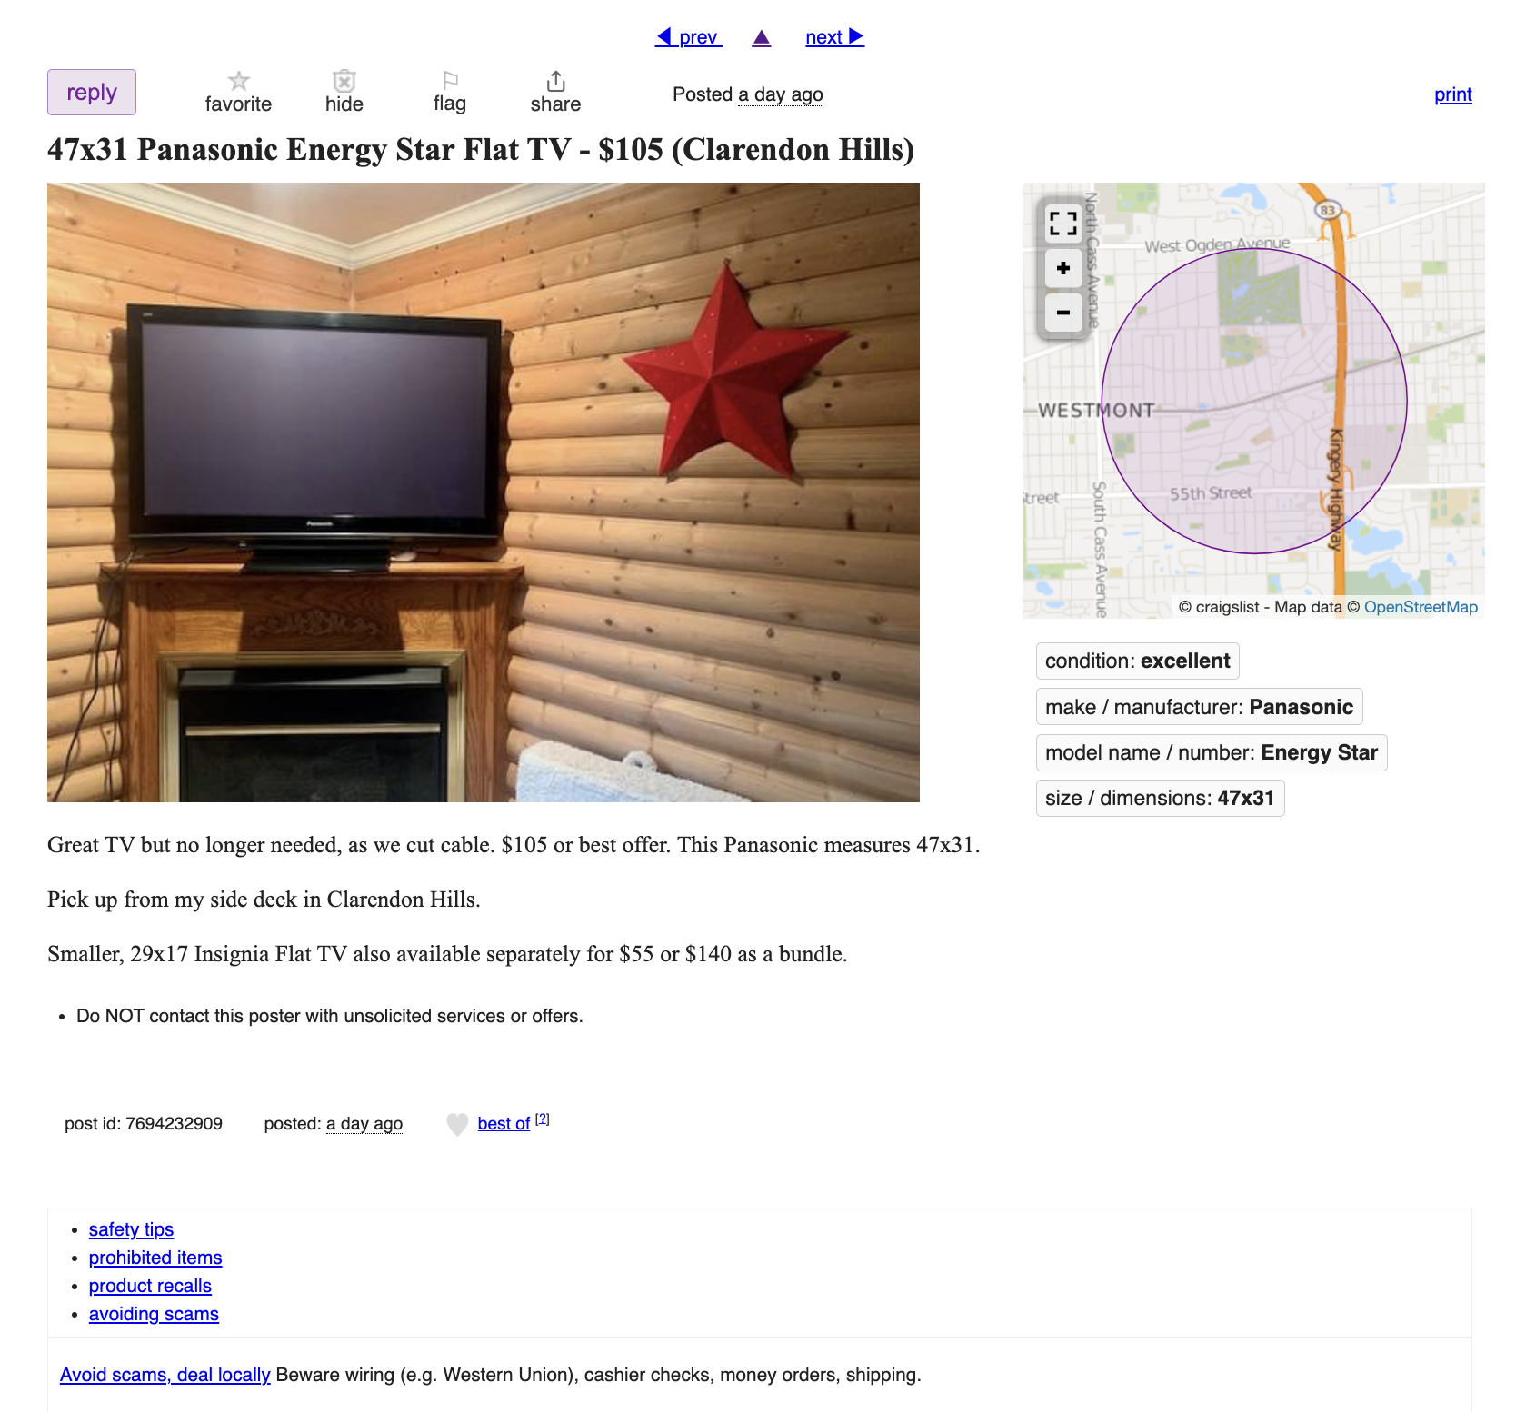
What is the challenge in Craigslist website?
Problem
Our Objective
Help Craigslist develop an Automated recommendation system that suggests wide variety of relevant complimentary products
Limited visibility of complementary products- no opportunity for cross selling or upselling through product recommendations
Objective
Business Impact
Our Methodology
Deployment
Learnings

Slide 3
Is this Recommendation system worth it?
Amazon’s Revenue Recommendation
Customer Engagement
Revenue Growth
Business Profits
35% of Amazon's revenue comes from recommendations - This includes a 29% increase in sales (Source: Evdelo)
110% more likely to add items, 40% more likely to overspend (source: BCG)
Average revenue lift of 25% or more, 20% improvement in loyalty scores (source: BCG)
CTR more than doubles, sales 1.7 times more effective with above-the-fold recommendations (Source: Invesp)
Objective
Business Impact
Our Methodology
Deployment
Learnings

Slide 4
How does this Recommendation system impact Craigslist?
Value Propositions:
Can offer cost-effective alternative products
Personalized recommendations based on location
Can strengthen brand image as an innovative platform
Increased user engagement and transaction frequency can increase market share
Customer Segments:
Buyers and sellers: Enables Self-service by automating product discovery process and improve customer satisfaction
Partners (Advertisers): Encourage more listings and visibility for advertisers
Cost Structure
IT Maintenance costs would increase
Payment Processing activities may increase, affecting associated costs.
Revenue Streams
With more personalized data, Craigslist could charge higher rates for targeted ads.
Paid Posts in Selected Categories
Objective
Business Impact
Our Methodology
Deployment
Learnings

Slide 5
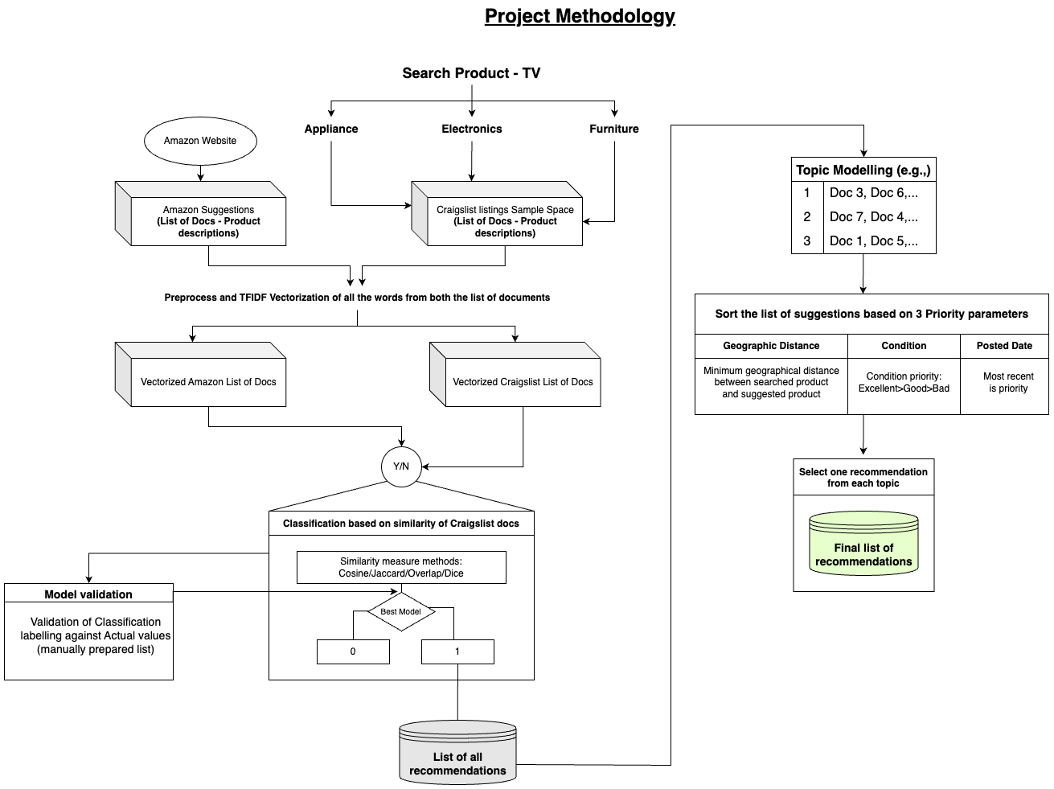
Starting our Methodology with our Approach overview
Objective
Business Impact
Our Methodology
Deployment
Learnings

Slide 6
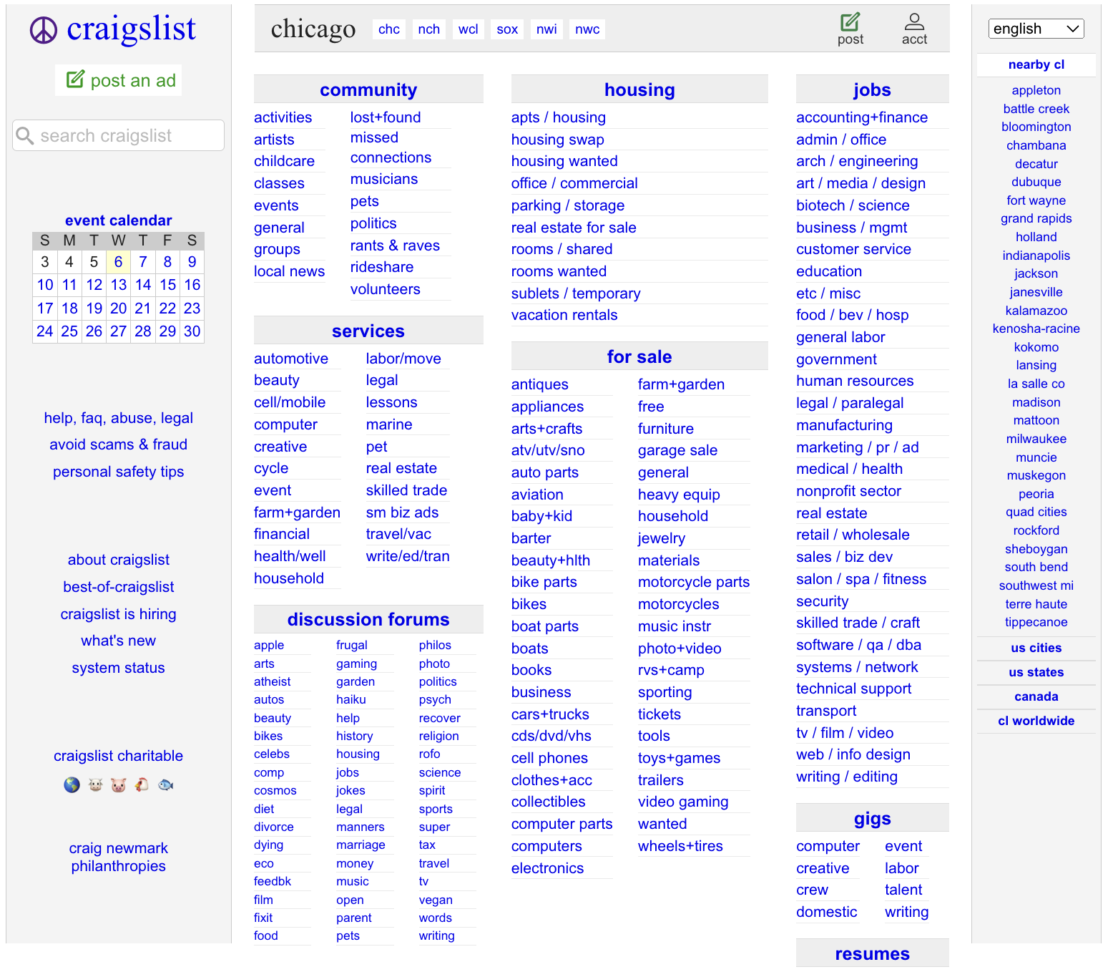
How does Craigslist Category page look like?
Objective
Business Impact
Our Methodology
Deployment
Learnings

Slide 7
How does Craigslist Product page look like?
Objective
Business Impact
Our Methodology
Deployment
Learnings

Slide 8
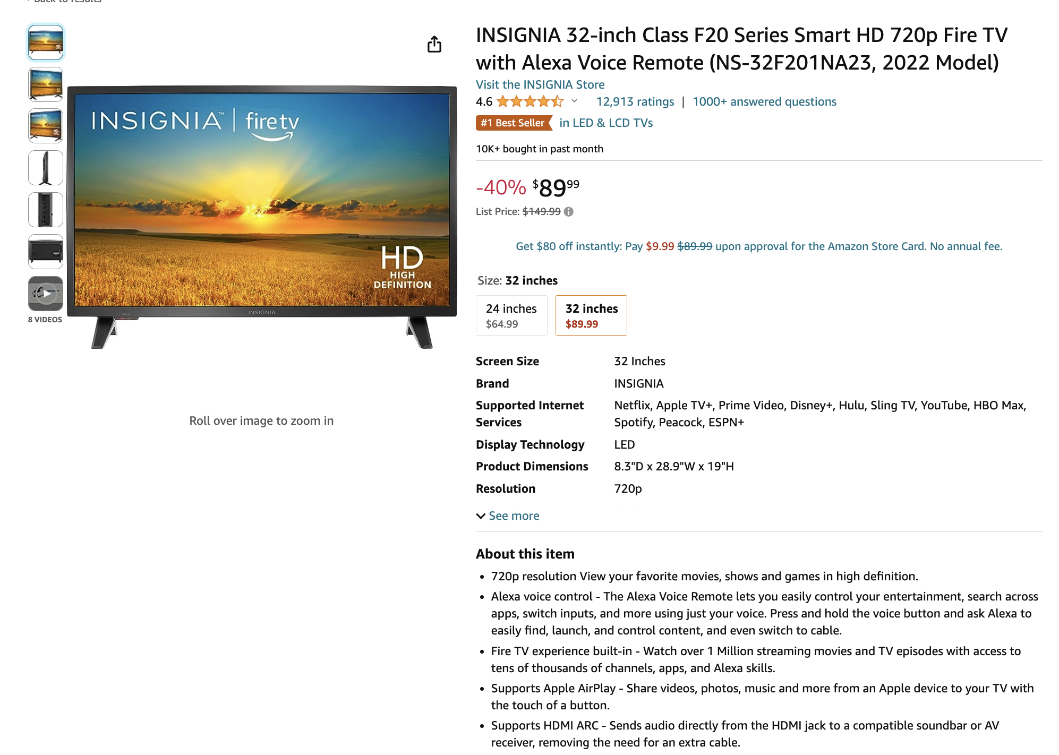
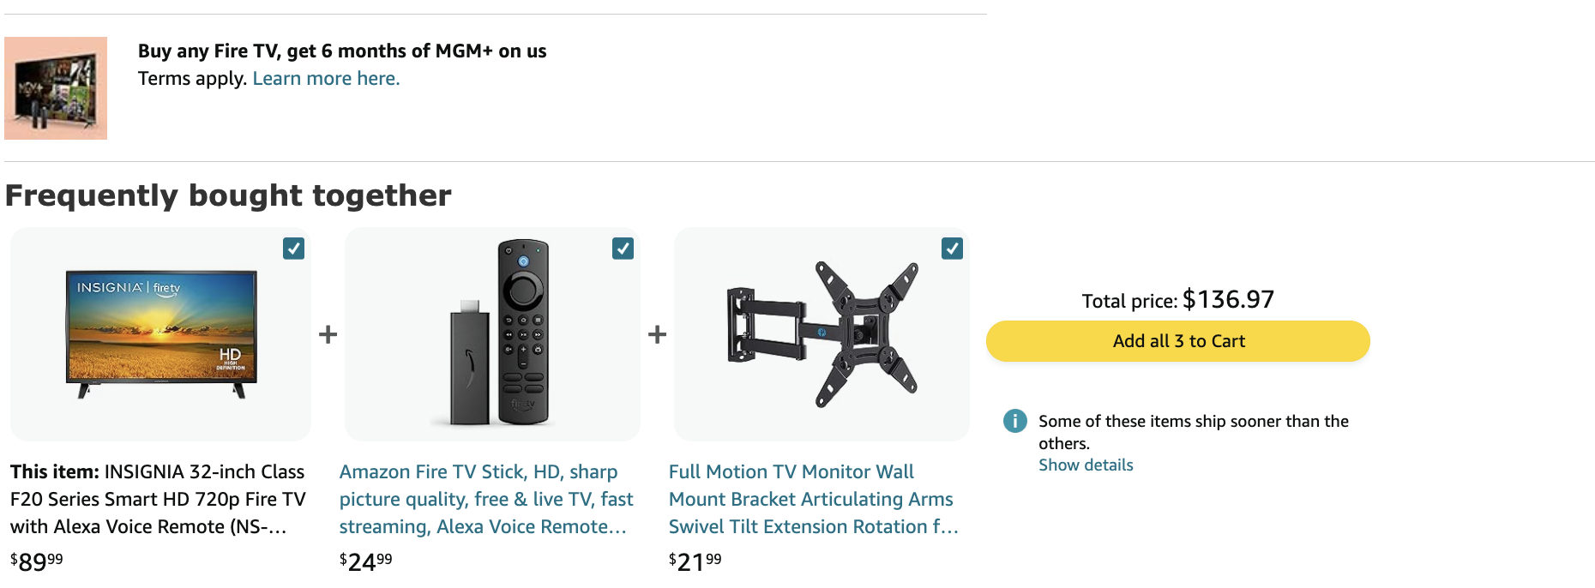
How exactly does Amazon Product page looks like?
Objective
Business Impact
Our Methodology
Deployment
Learnings

Slide 9
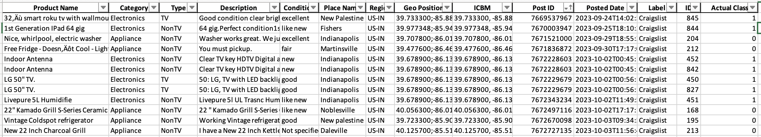
What data do we require and how do we extract?
Sources:
Craigslist (Classifieds) and
Amazon (E-commerce)
Technique:
Web Scraping with Selenium
Craigslist Extraction:
848 Products
Categories:
Data Points:
Geo-Position(Lat, Long)
Amazon Extraction:
10 Products
Data Points: Product Name and Product Description
Electronics
Appliances
Furniture
Product Name
Category
Product Description
Condition
Posted Date
Post ID
Our sample of scraped data from Craigslist (also include manually entered class)
Objective
Business Impact
Our Methodology
Deployment
Learnings

Slide 10
Our Methodology
Objective
Business Impact
Our Methodology
Deployment
Learnings

Slide 11
Our Methodology
Objective
Business Impact
Our Methodology
Deployment
Learnings

Slide 12
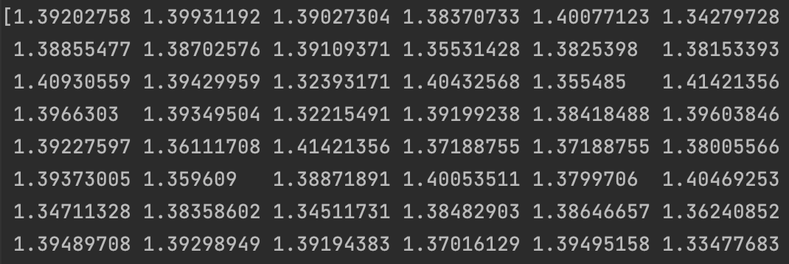
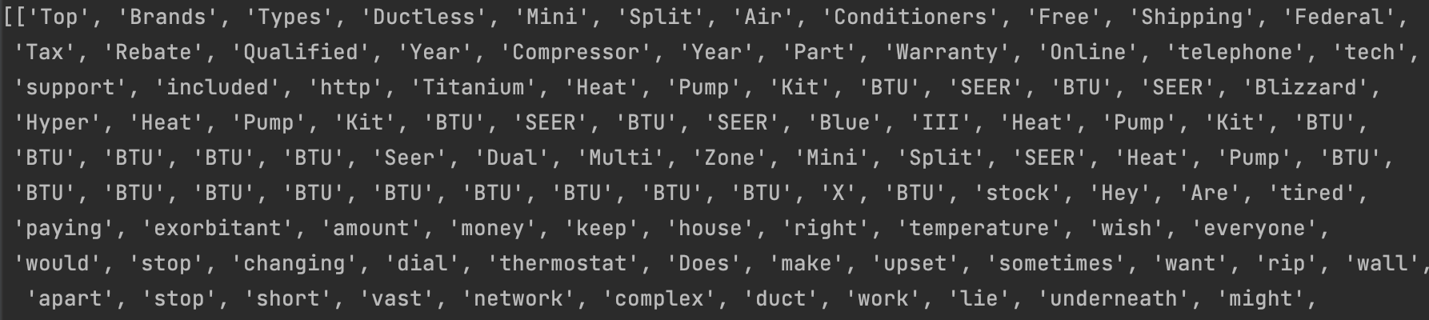
Steps - Data Preprocessing to forming separate lists of vectors
Pre-processing
Removing nulls
Tokenization
Removing stop words and punctuations
Lemmatization
Vocabulary and Vectorization
Combining the data to build a vocabulary (helps in ensuring same dimensionality)
TFIDF Vectorization for combined docs of Craigslist and Amazon
Separate the list of vectors
Find the distances of craigslist vectors from all the vectors Amazon vectors
Identify the minimum distance of every Craigslist vector from the Amazon vectors
Objective
Business Impact
Our Methodology
Deployment
Learnings

Slide 13
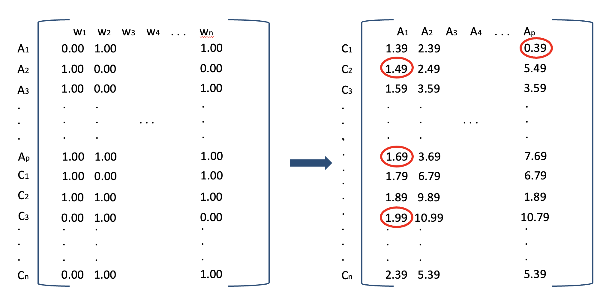
Visual - Data Preprocessing to forming separate lists of vectors
Distances between Craigslist and Amazon listings
TFIDF
Objective
Business Impact
Our Methodology
Deployment
Learnings

Slide 14
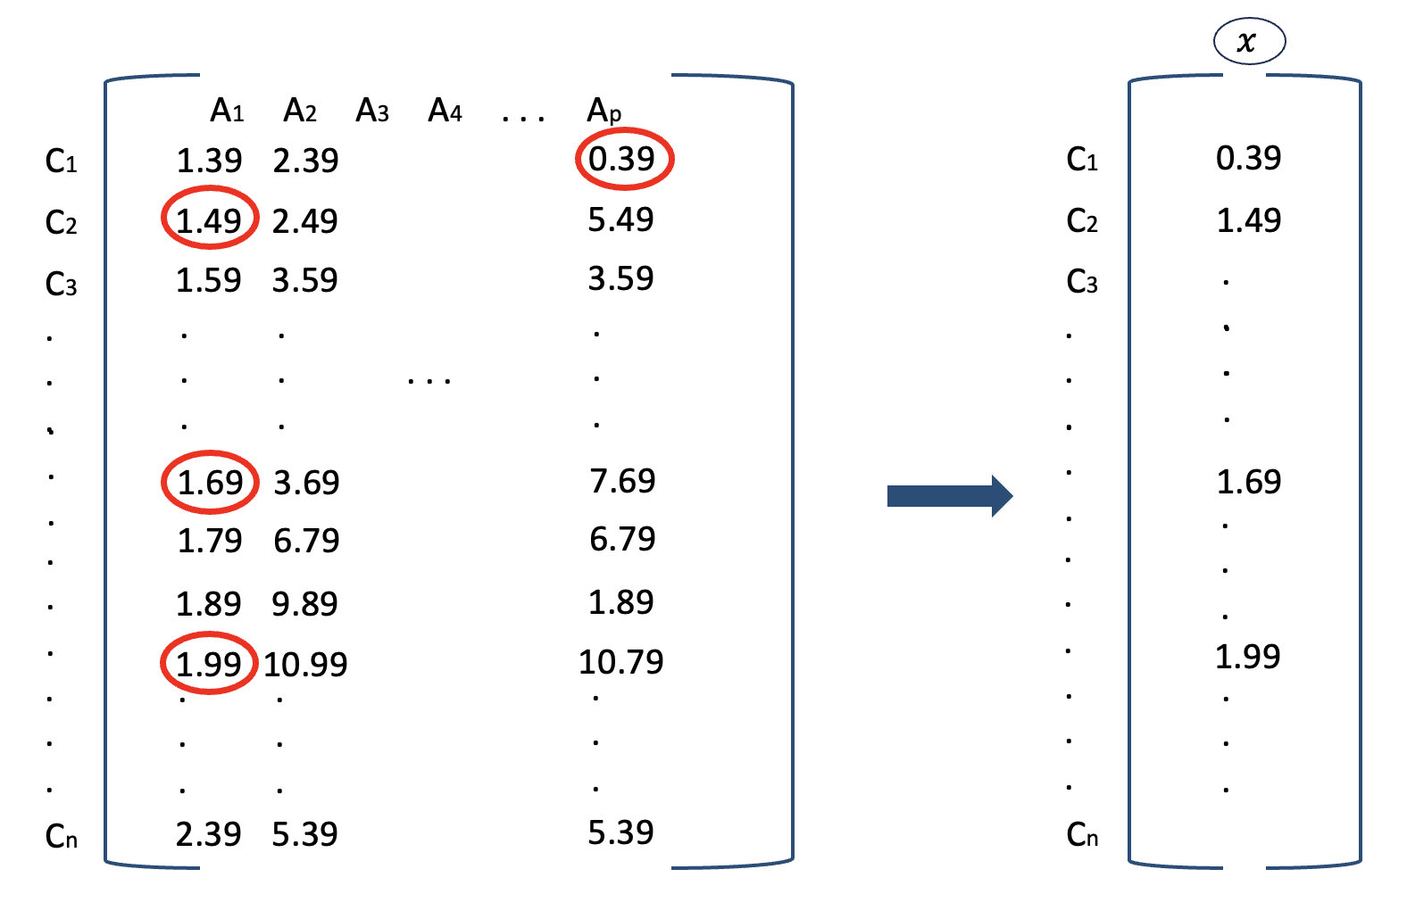
Visual - Data Preprocessing to forming separate lists of vectors
Distances between Craigslist and Amazon listings
Minimum Distance
Objective
Business Impact
Our Methodology
Deployment
Learnings

Slide 15
Our Methodology
Objective
Business Impact
Our Methodology
Deployment
Learnings

Slide 16
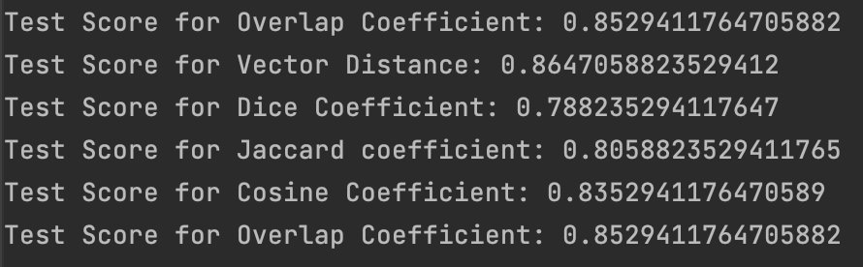
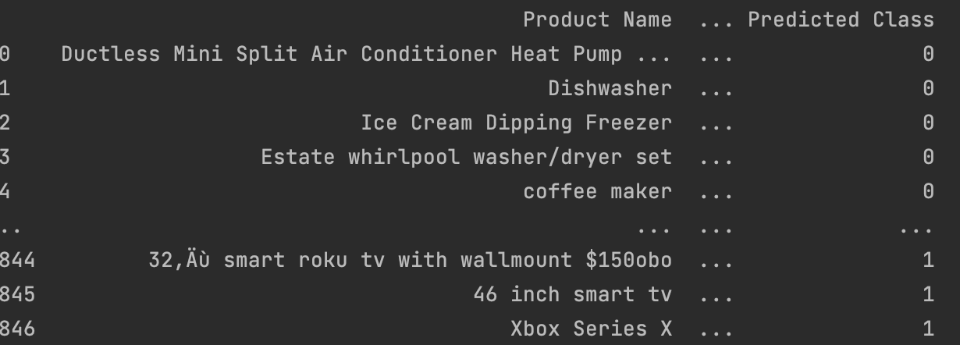
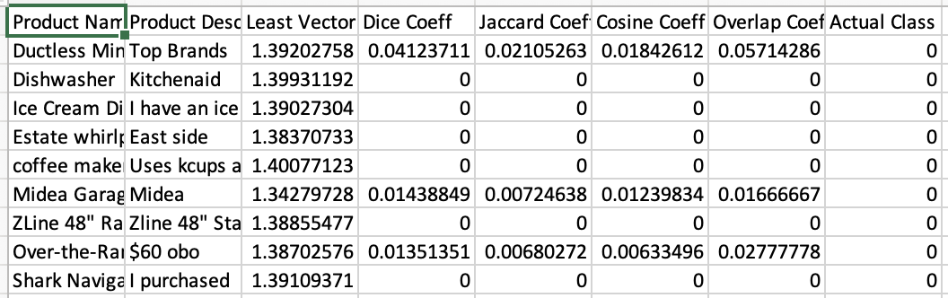
Steps – Classification based on similarity coefficients
Compare Similarity coefficients
Dice
Jaccard
Cosine
Overlap
Identify best model through Cross-validation
Our best Vector distance model is Vector Distance model with 86.4% accuracy
Proceed with Vector distance model to predict classification of TV related or not
List of all TV recommendations is proceeded further
Objective
Business Impact
Our Methodology
Deployment
Learnings

Slide 17
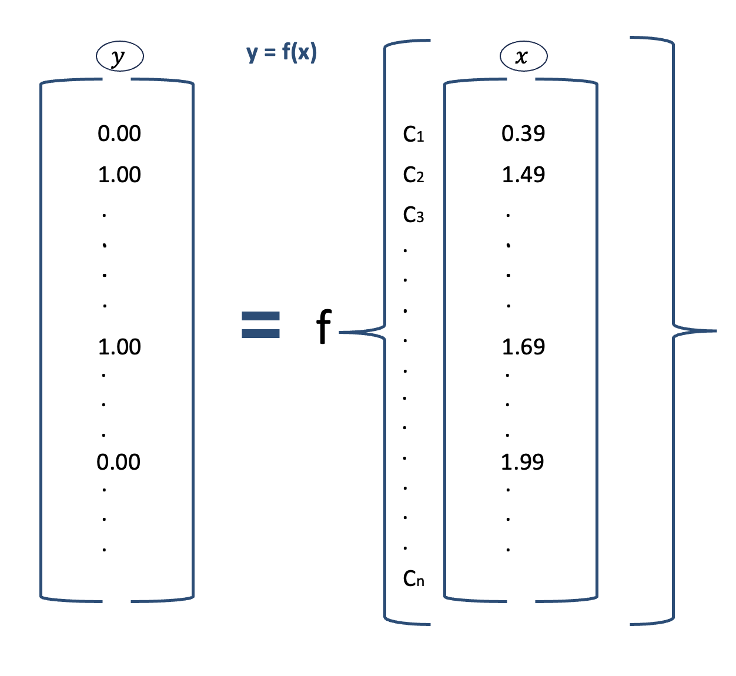
Steps – Classification based on similarity coefficients
Objective
Business Impact
Our Methodology
Deployment
Learnings

Slide 18
Our Methodology
Objective
Business Impact
Our Methodology
Deployment
Learnings

Slide 19
Our Methodology
Objective
Business Impact
Our Methodology
Deployment
Learnings

Slide 20
Our Methodology
Objective
Business Impact
Our Methodology
Deployment
Learnings

Slide 21
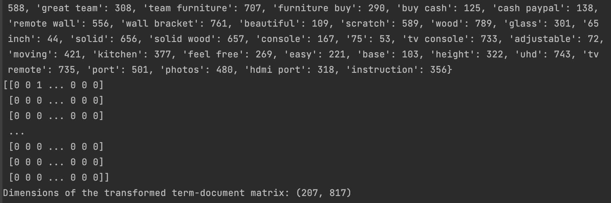
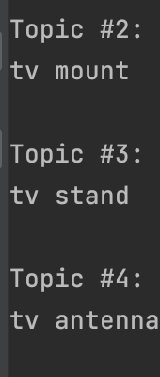
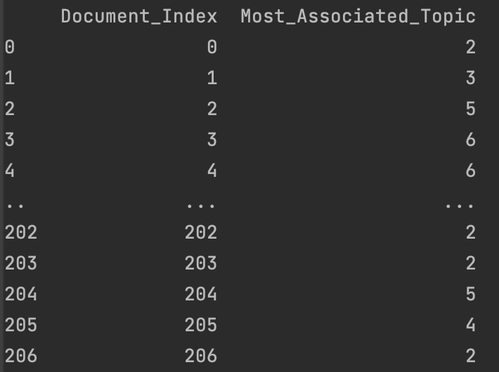
Why do we need Topic Modelling?
“Diverse set of recommendation can have higher conversion rate than the monotonous list of recommendations”
LDA Topic Modeling
Data Integration and topic naming
Identify most relevant topic for each Craigslist listing
Generate a term-document matrix using CountVectorizer.
Join topic data with the original Data Frame
Apply Latent Dirichlet Allocation to identify 10 topics.
Determine dominant topics for each document and create a corresponding Data Frame
Assign and update topic names based on top 2 words in each topic.
Term-document matrix
10 Topics
Most related topic for docs
Objective
Business Impact
Our Methodology
Deployment
Learnings

Slide 22
Our Methodology
Objective
Business Impact
Our Methodology
Deployment
Learnings

Slide 23
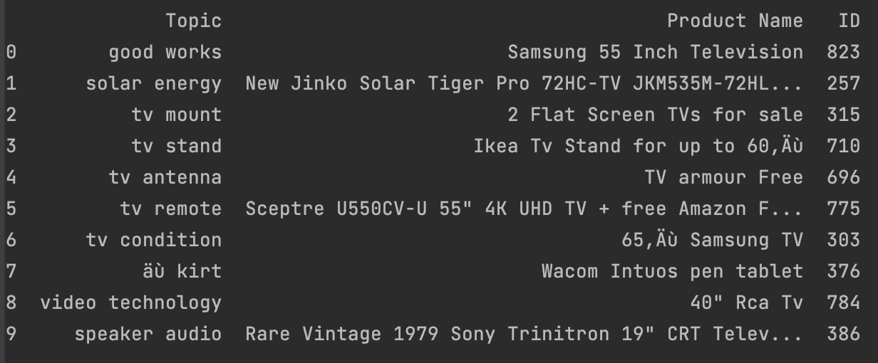
We only want one recommendation each for 10 topics
Pickup the top product from each topic after sorting based on the following parameters
Condition of the product: Excellent>Likely New>New>Good>Others (random)
Date of listing should be as recent as possible – Sorts by active post and high conversion probability
Distance of recommended products from a particular place (e.g., Indianapolis) should be minimum. Future scope – Distance between searched product and recommended products can be compared
Objective
Business Impact
Our Methodology
Deployment
Learnings

Slide 24
Deployment and Improvements
Deployment considerations
Should be much easier if Sales data of Craigslist is available
Needs to be developed for various categories
Manual data labelling, though the best method, could contain errors.
Scope for improvement
Could Augment this model with the historical information available
For better accuracy
Customer Satisfaction
Products sold faster (seller satisfaction)
Location distance from product viewed and the list of recommendations can be considered
Objective
Business Impact
Deployment
Learnings
Our Methodology

Slide 25
What did we learn by working on this project?
Business context blending
Sample sizes effect on model
Objective
Business Impact
Learnings
Our Methodology
Deployment

Slide 26
Questions?

Slide 27
Appendix

Slide 28
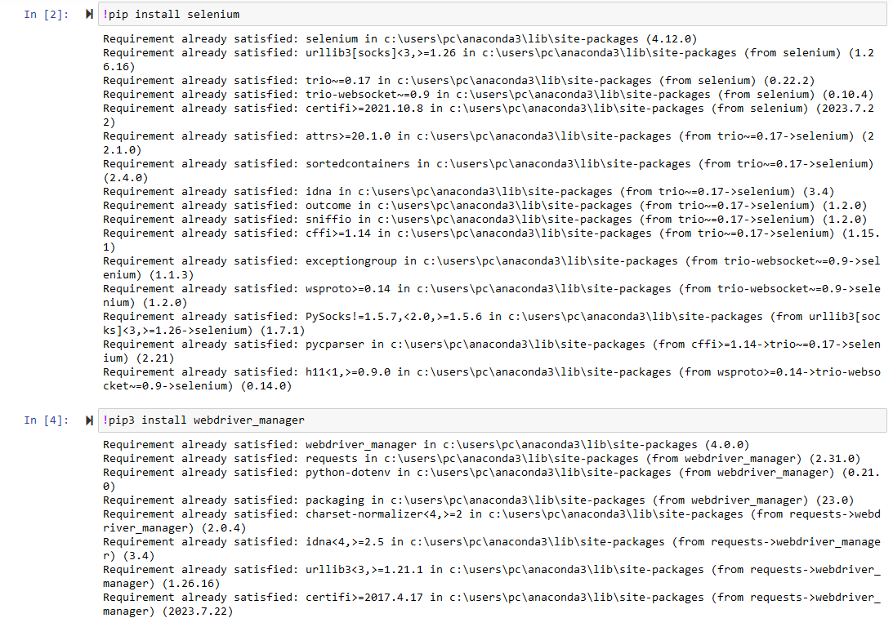
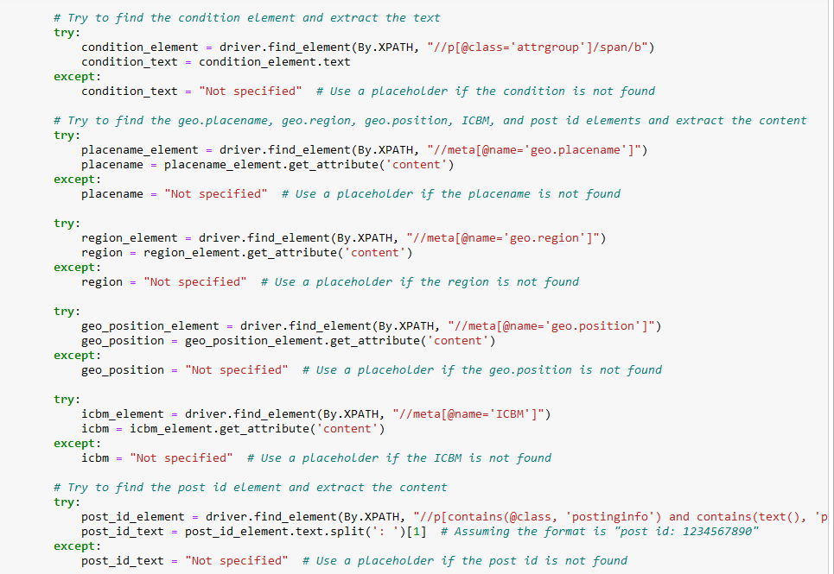
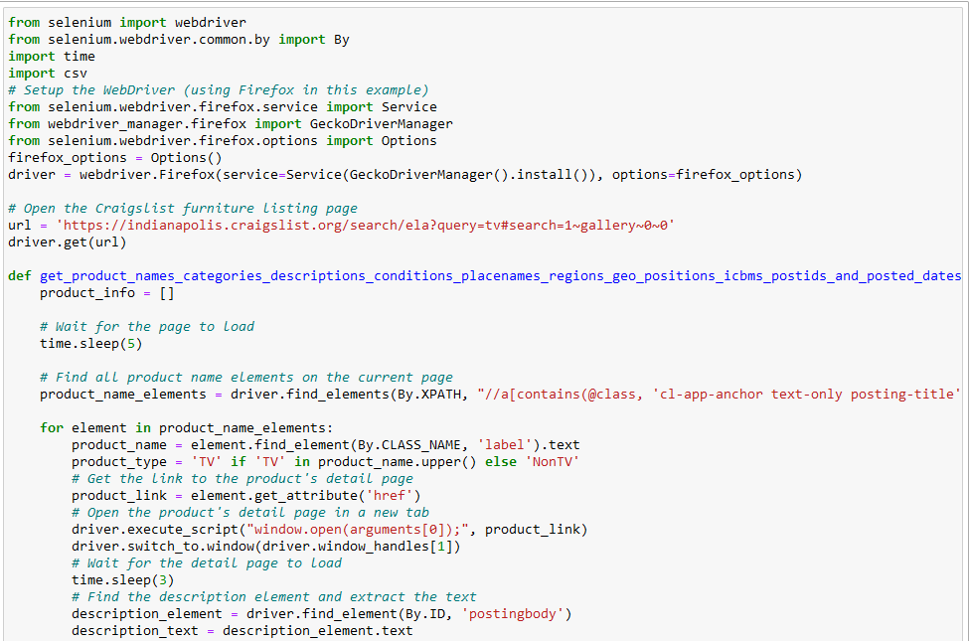
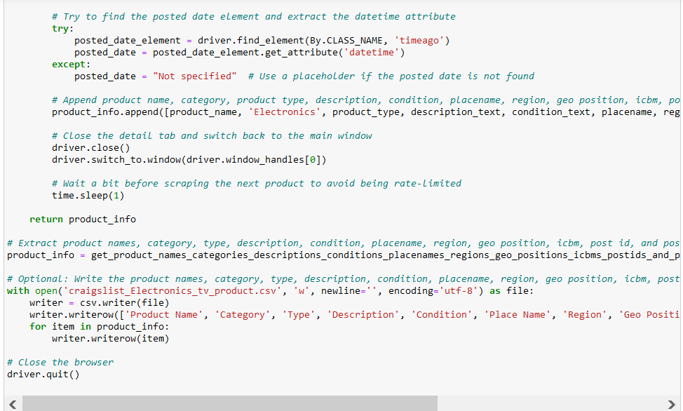
Data Scrapping

Slide 29
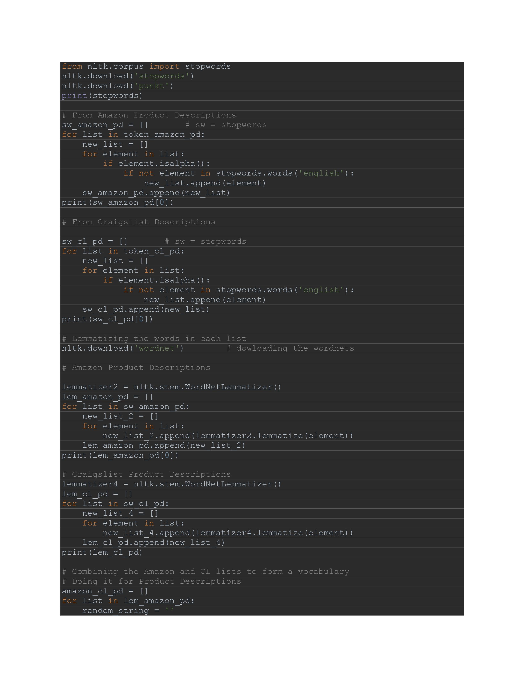
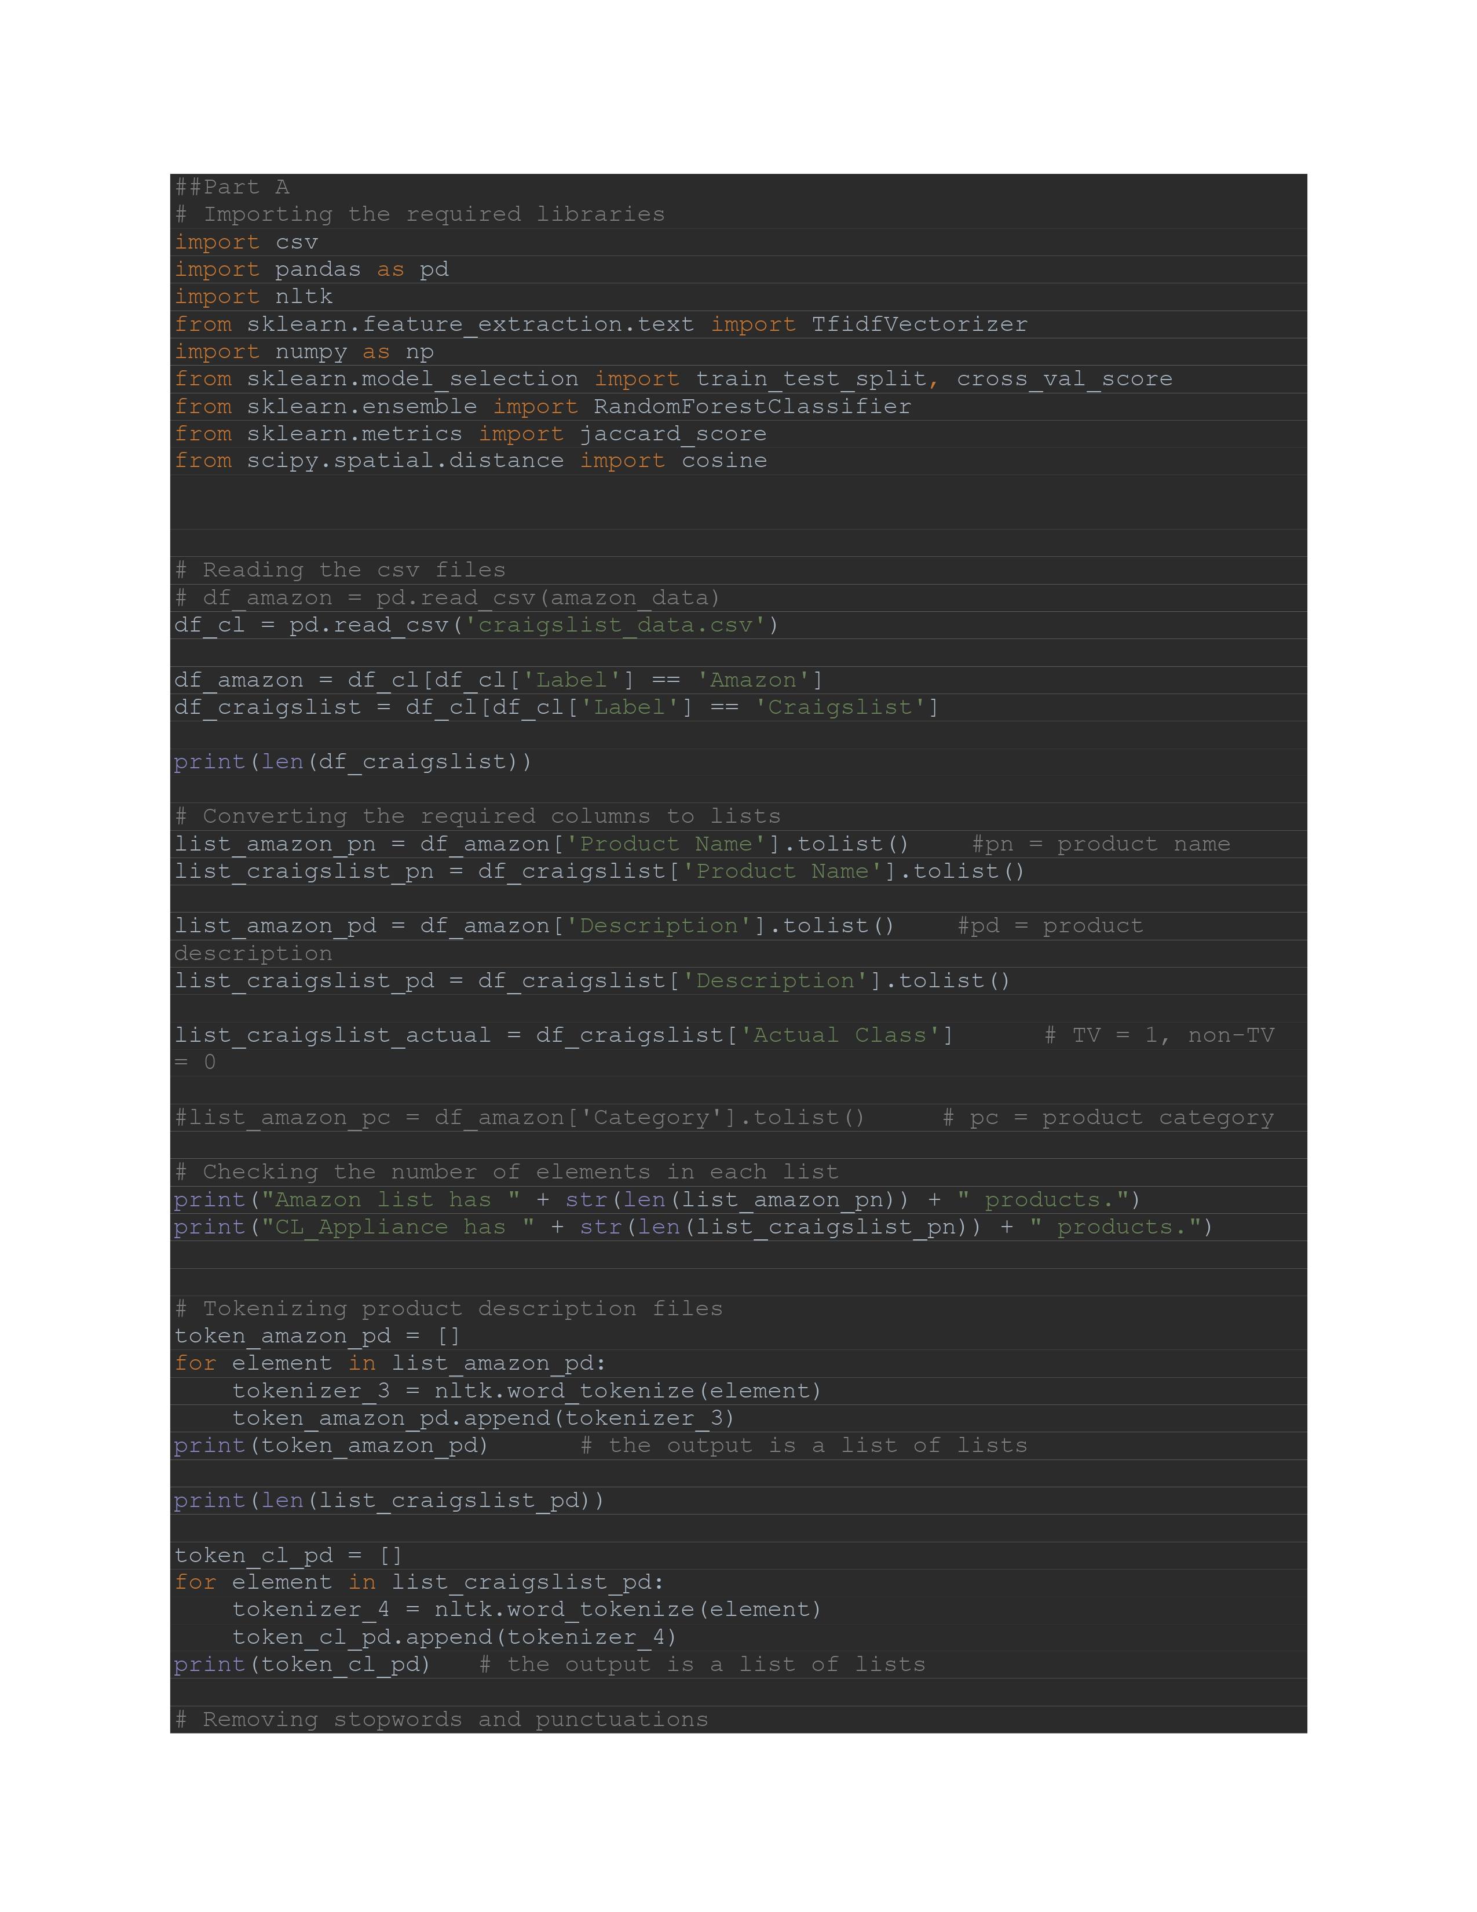
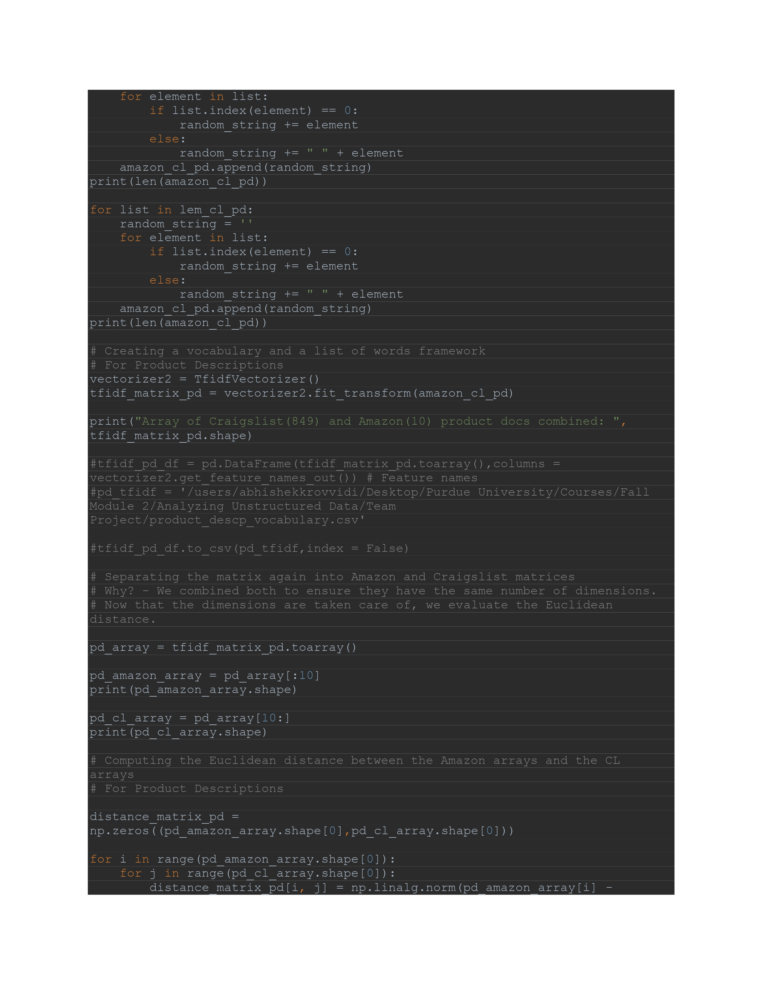
Classification Model and Topic Modelling

Slide 30
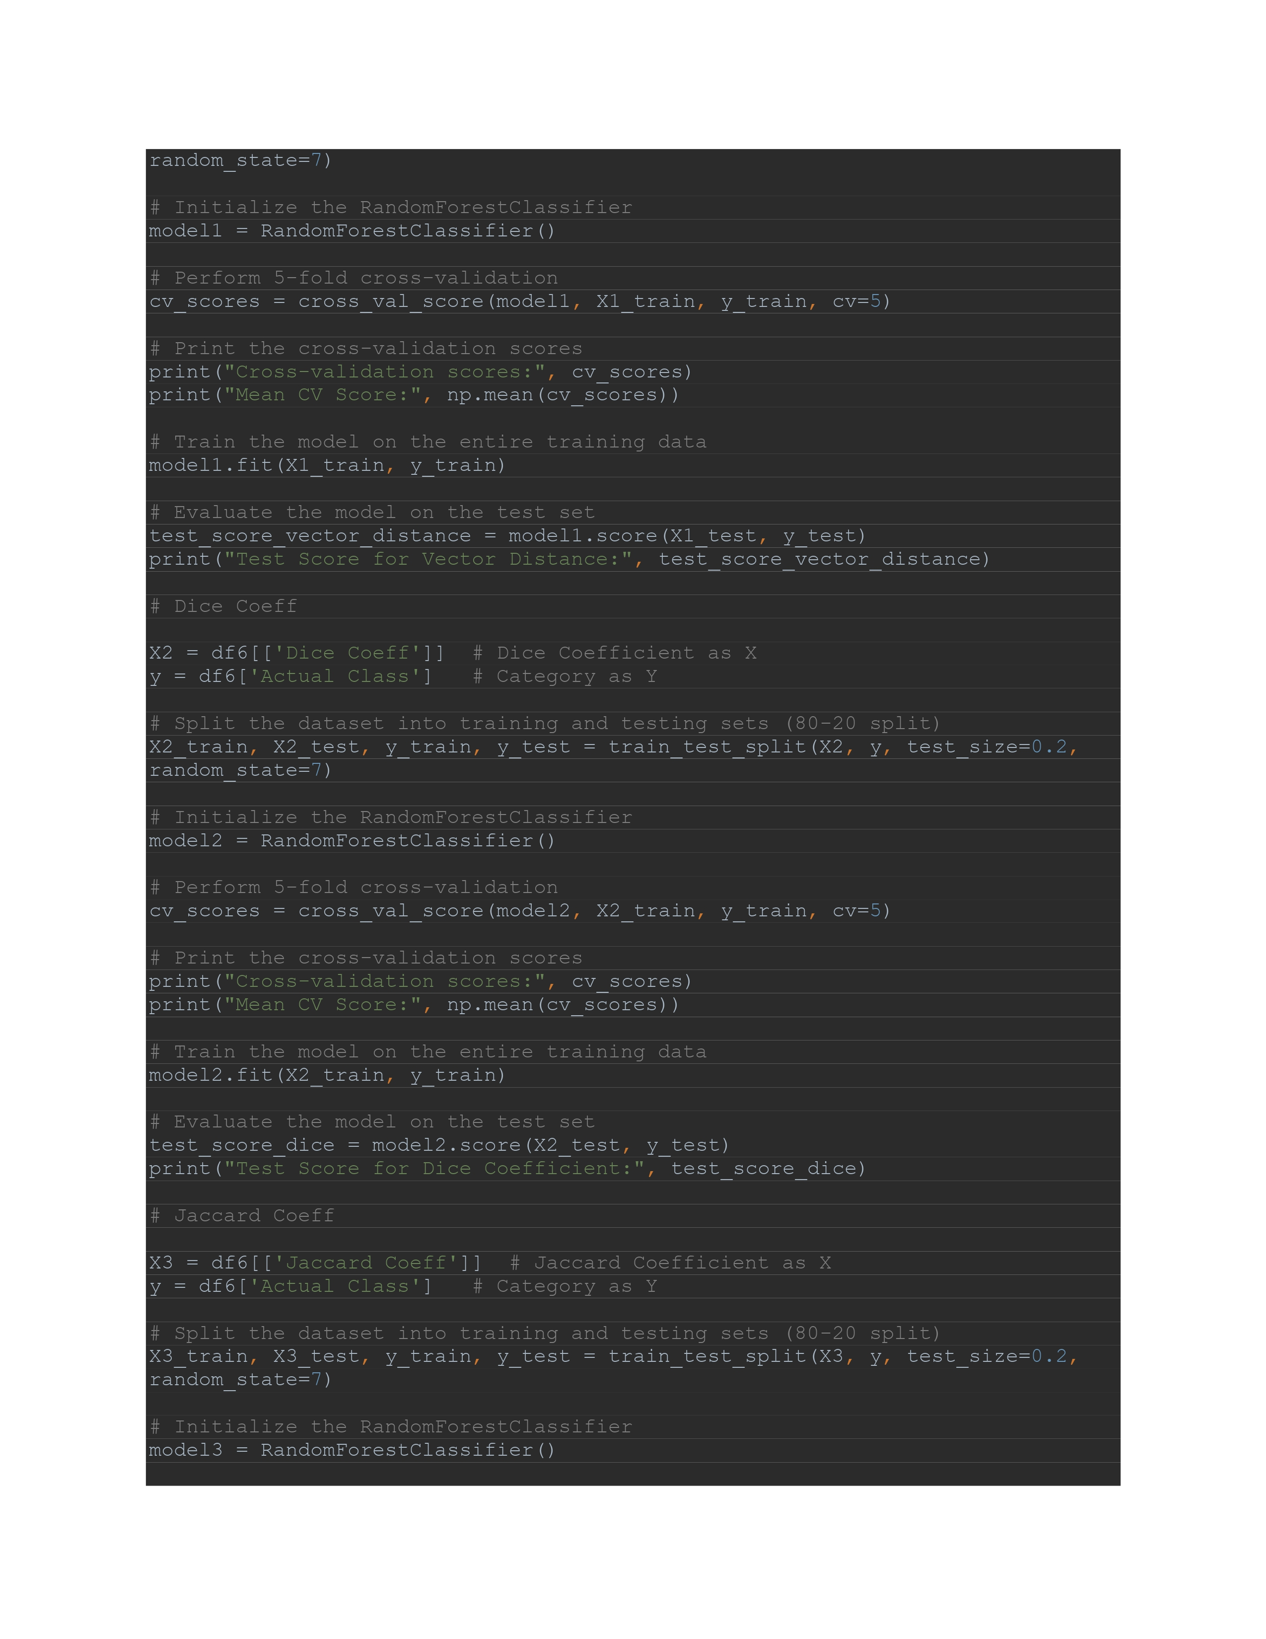
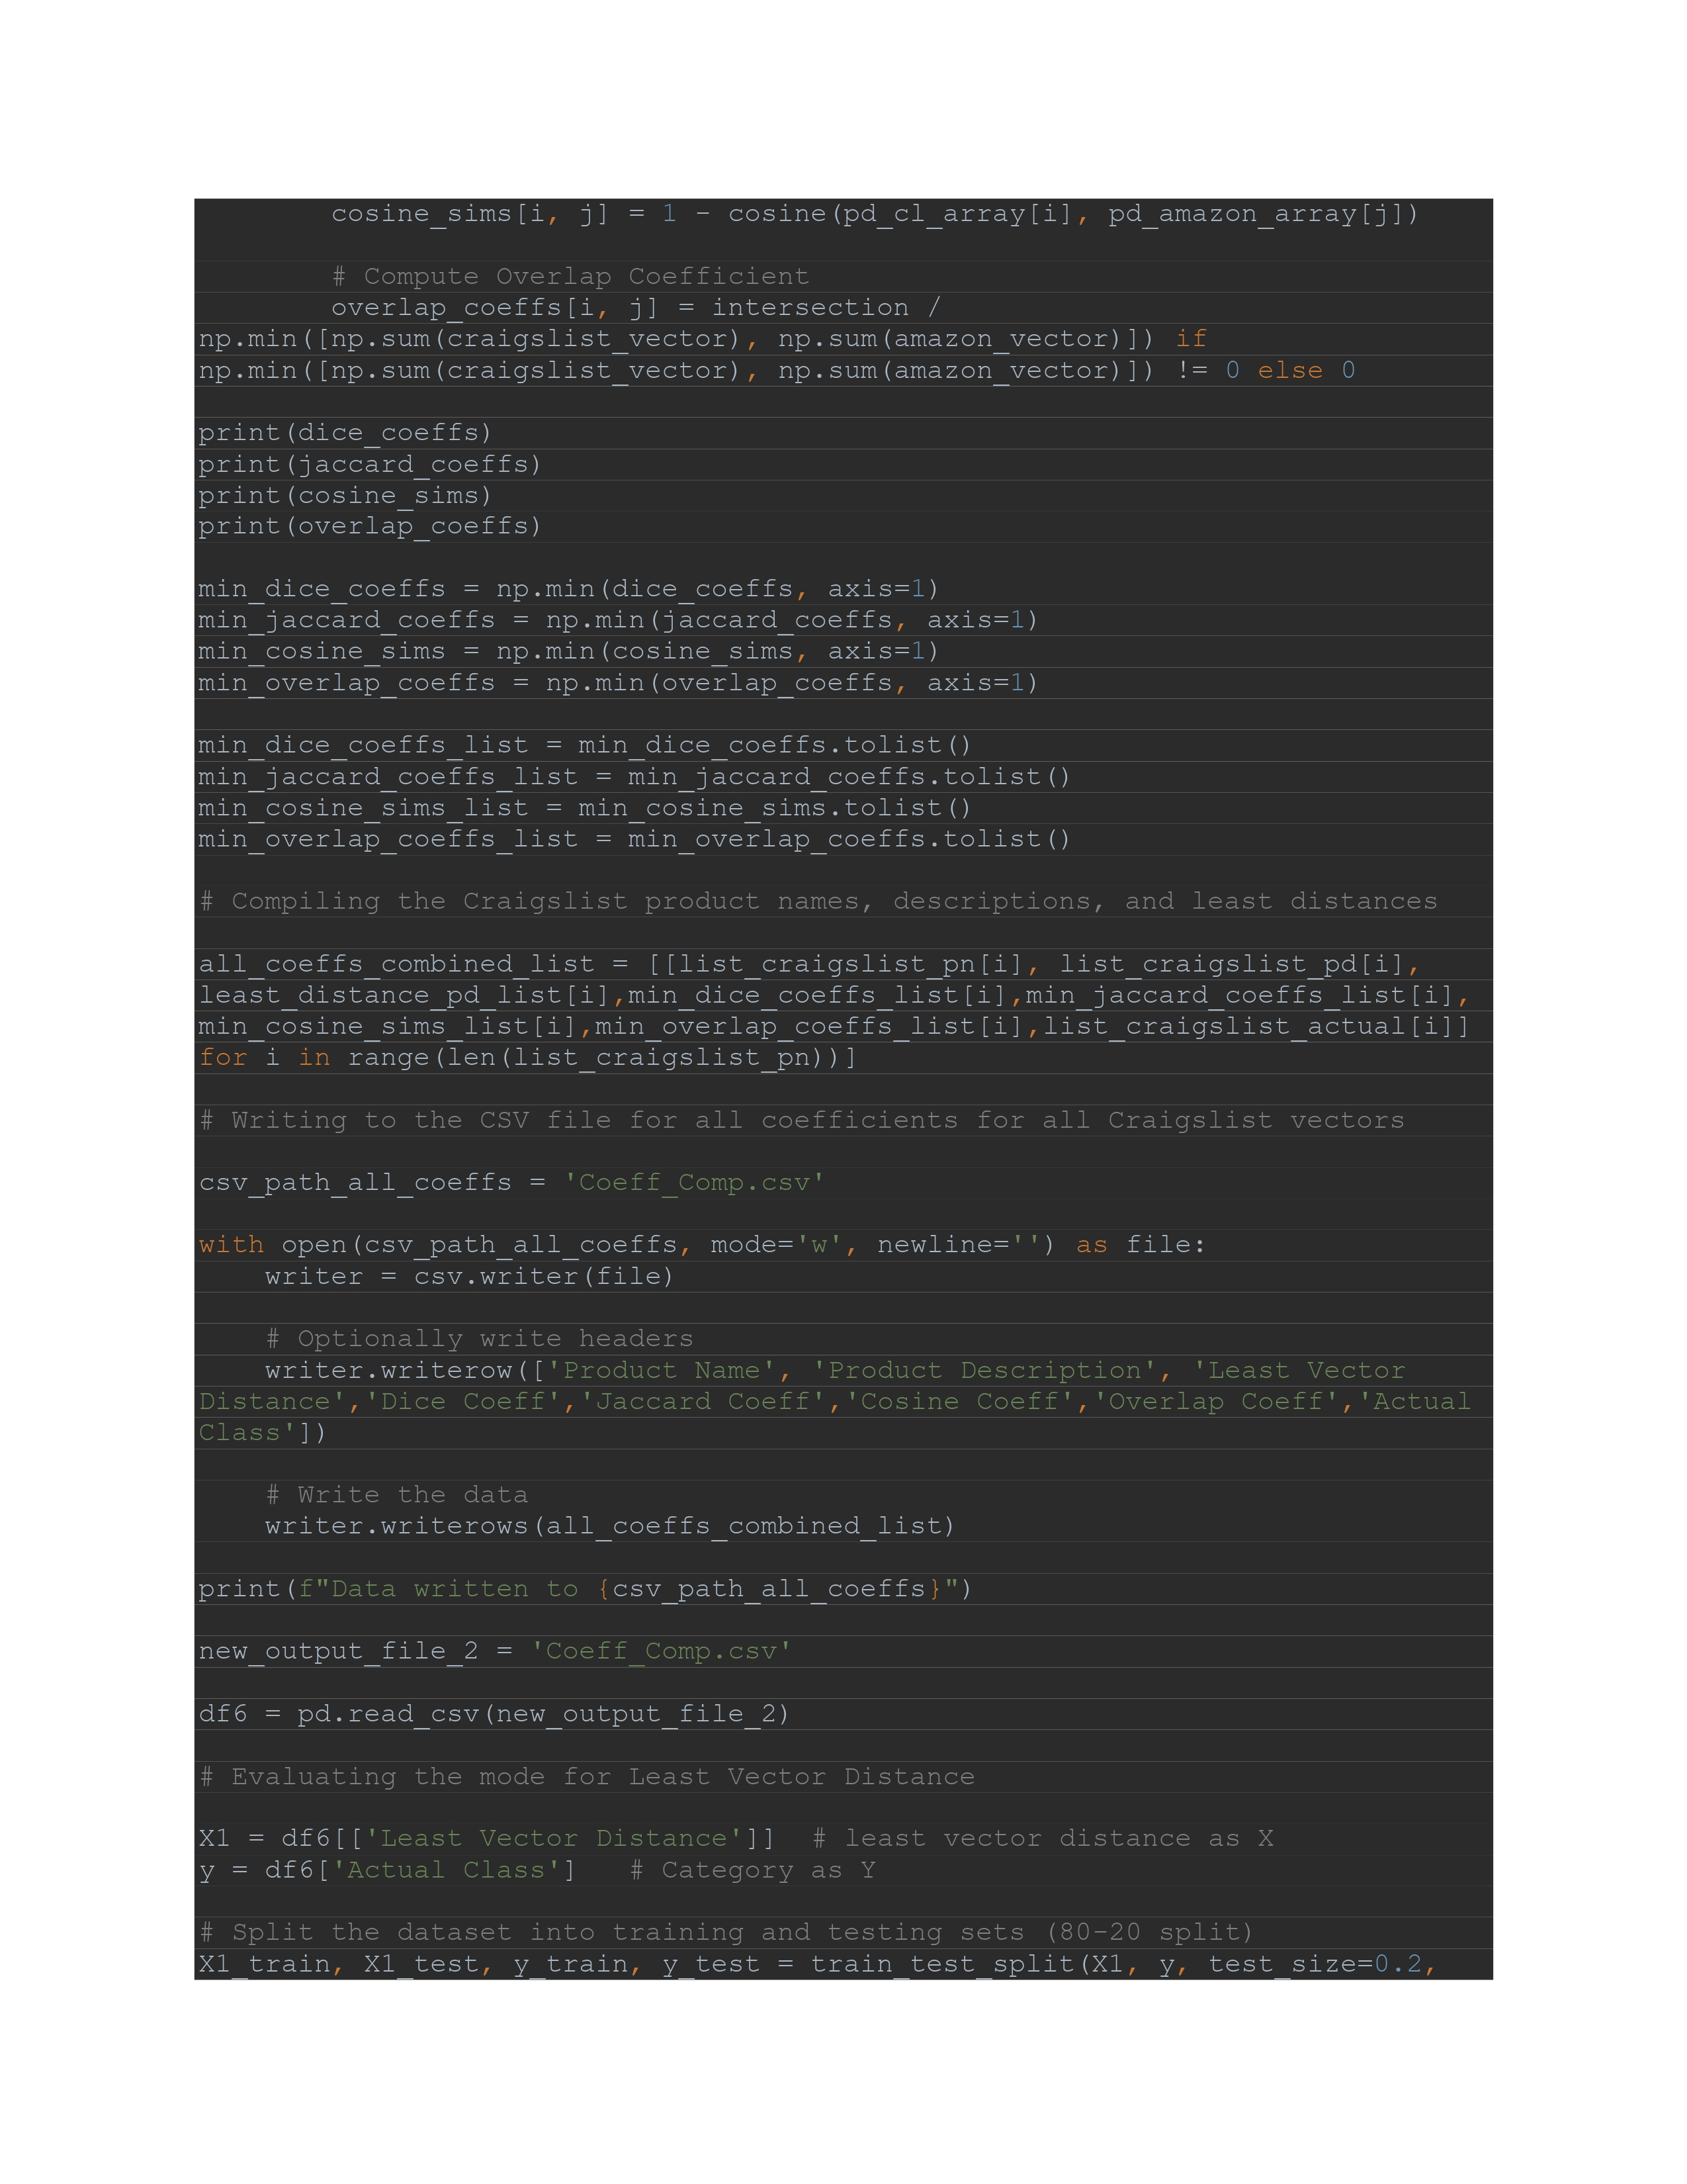
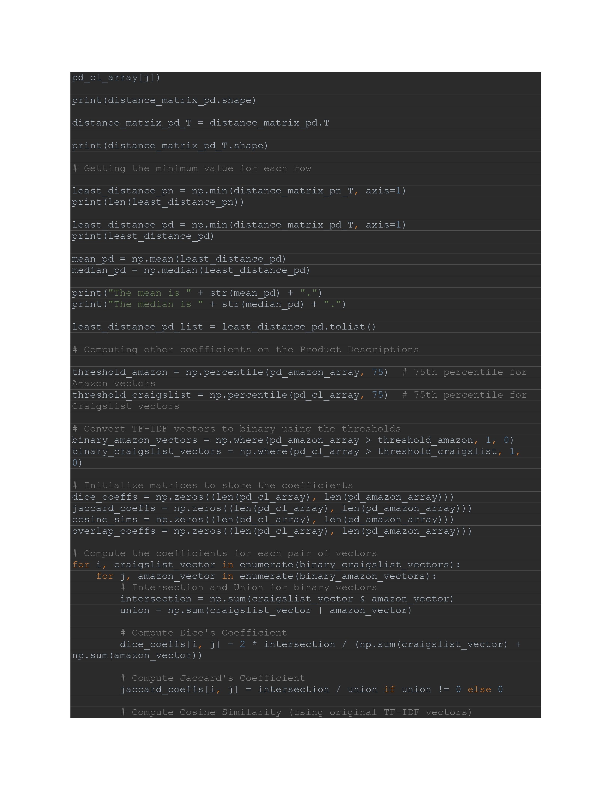
Classification Model and Topic Modelling

Slide 31
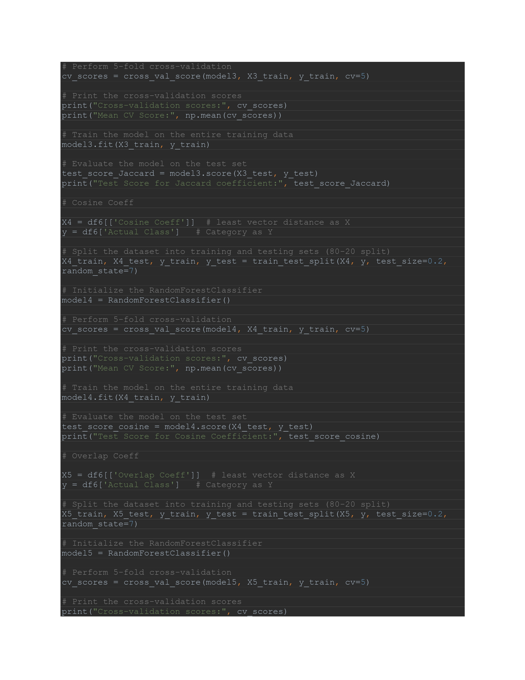
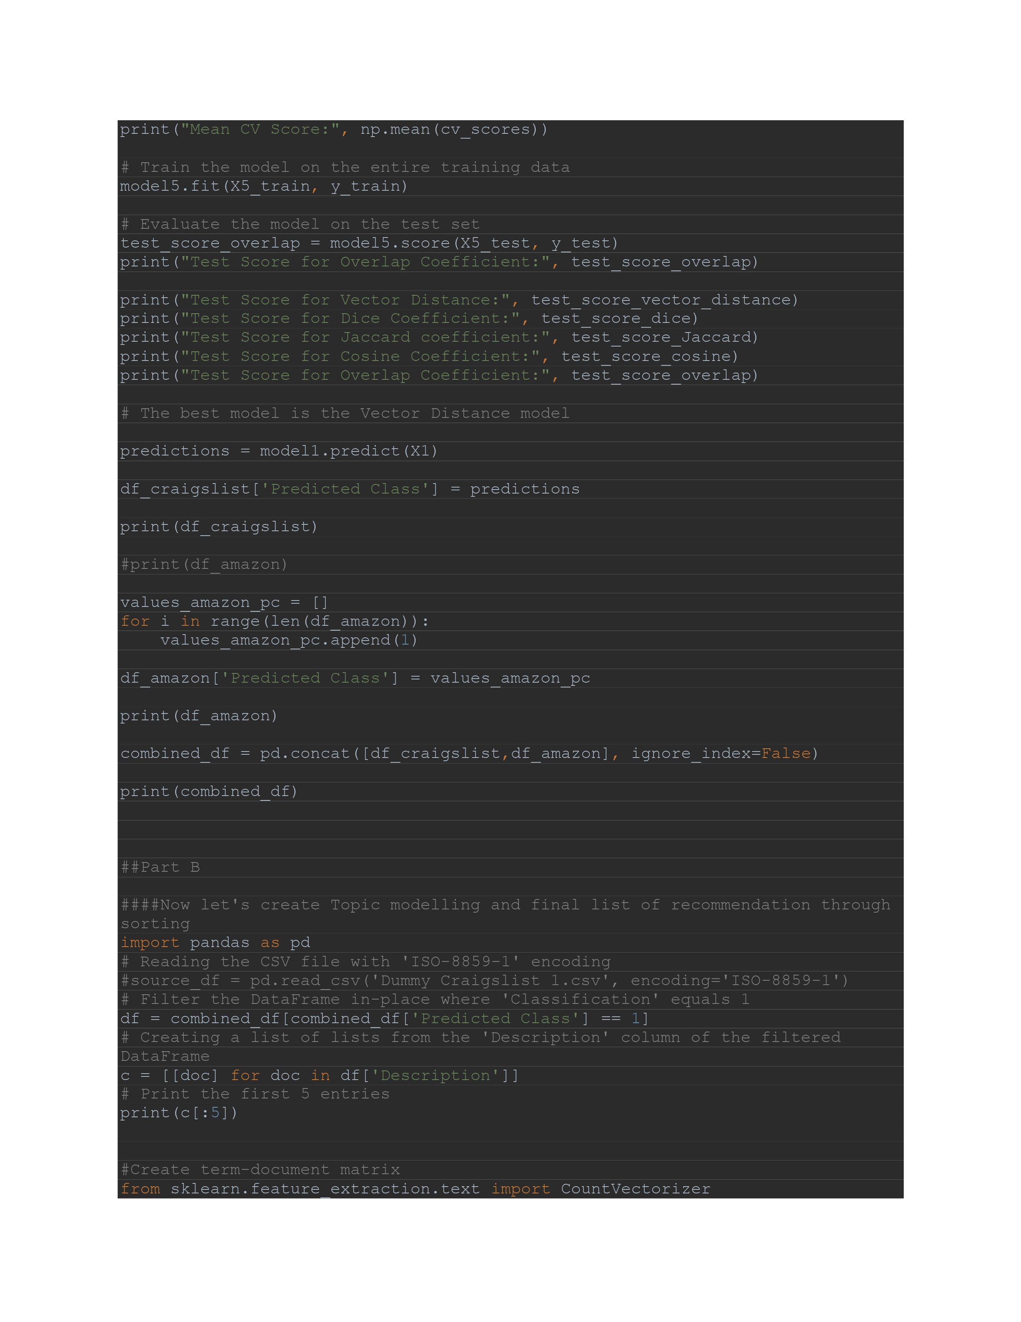
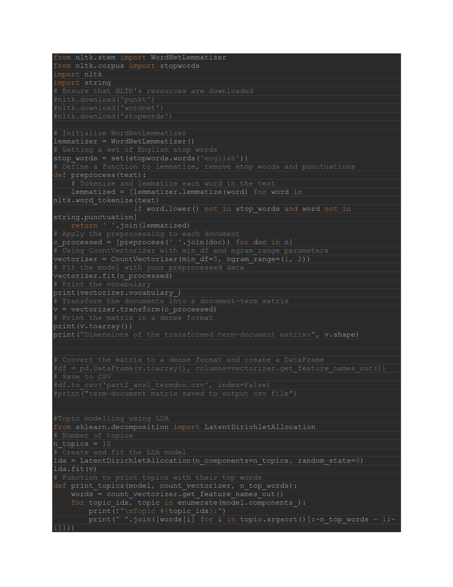
Classification Model and Topic Modelling

Slide 32
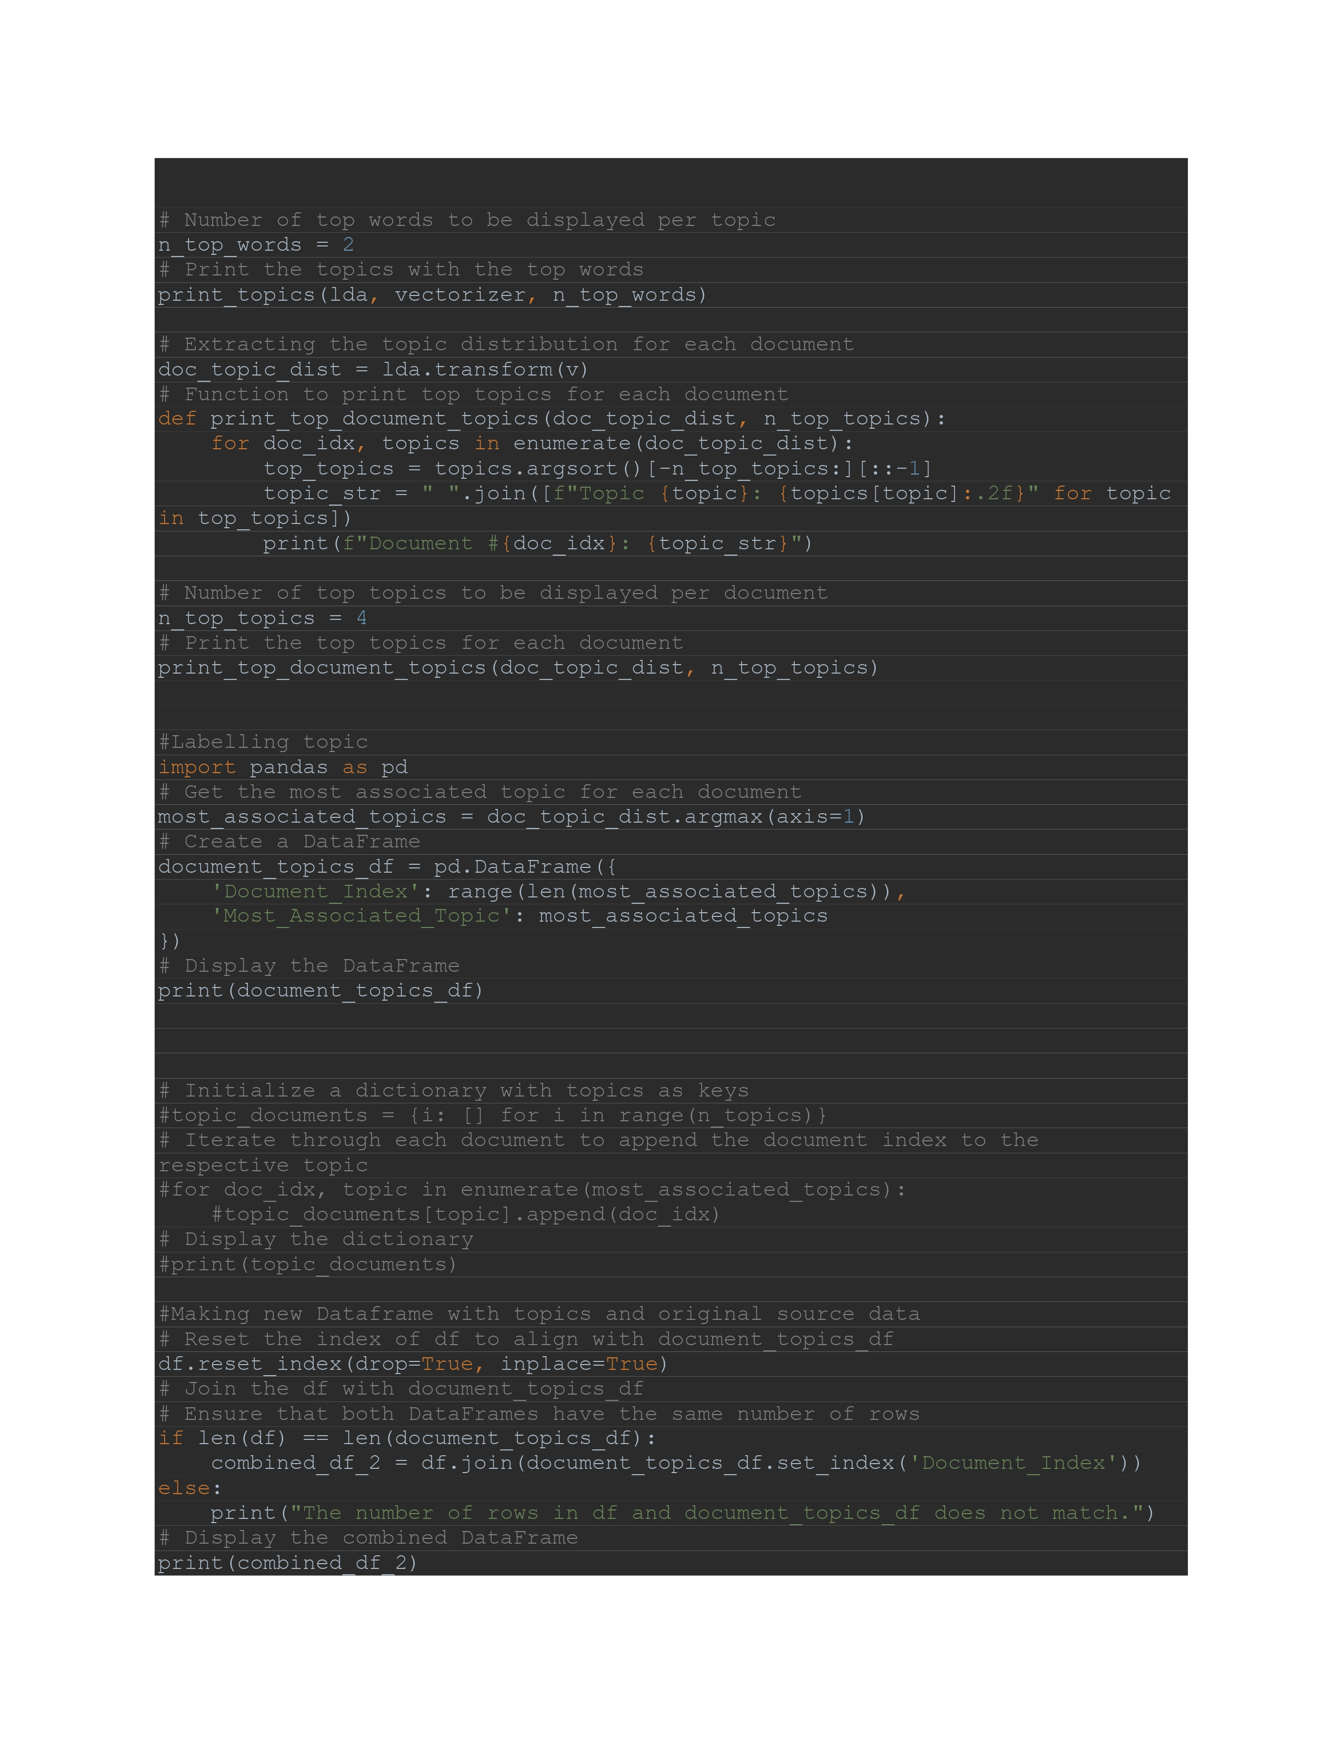
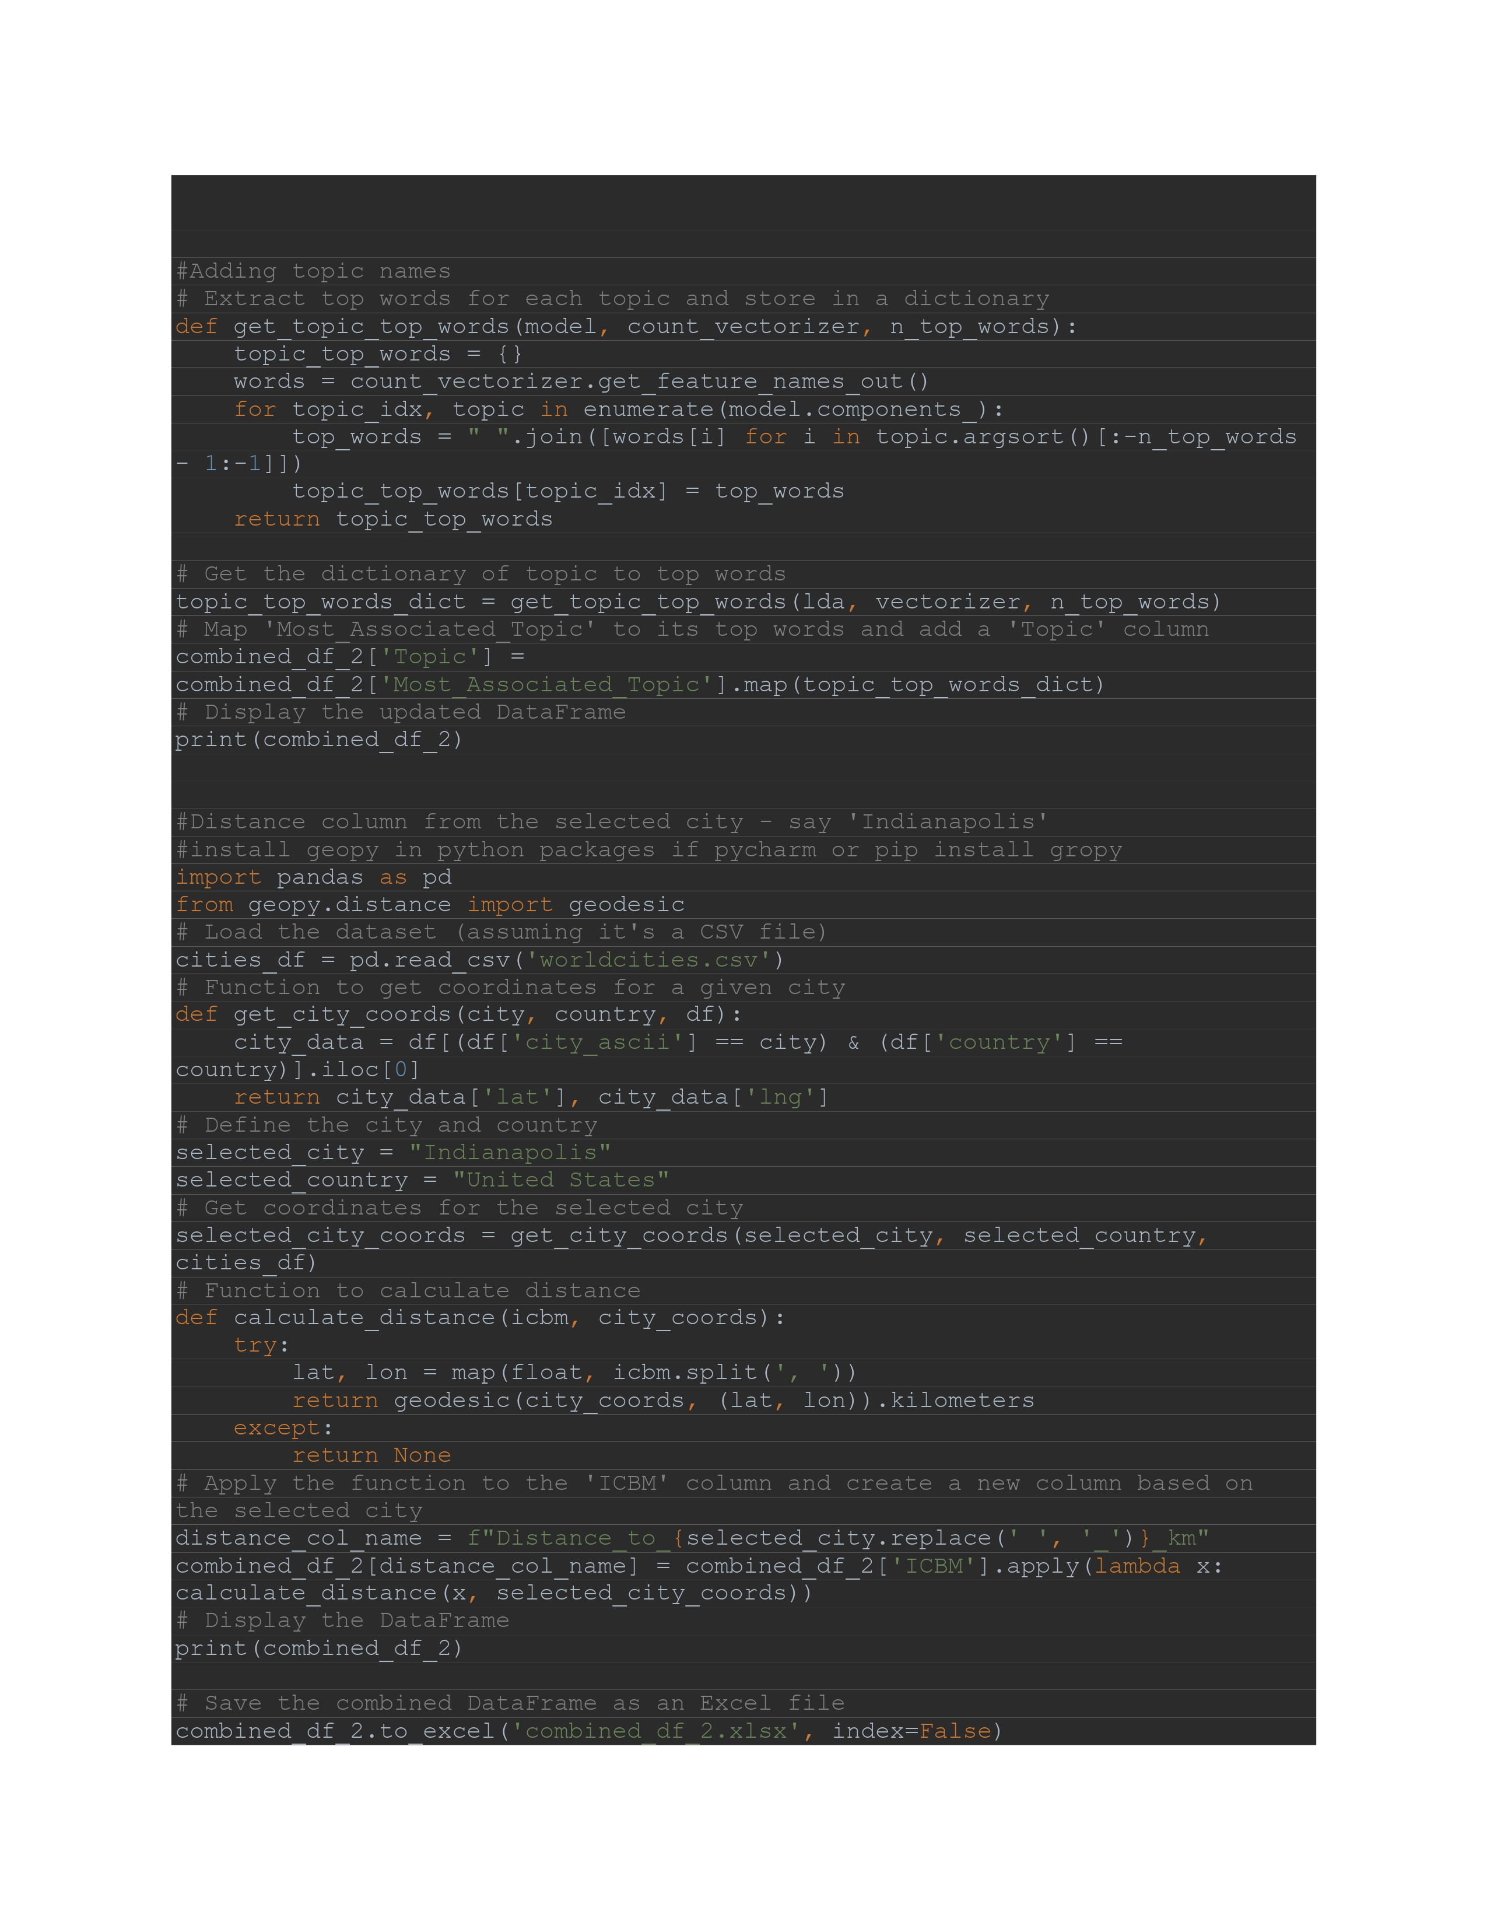
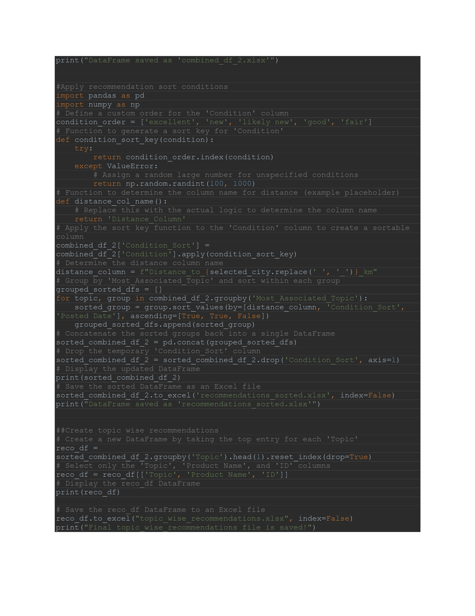
Classification Model and Topic Modelling

